Slide 1

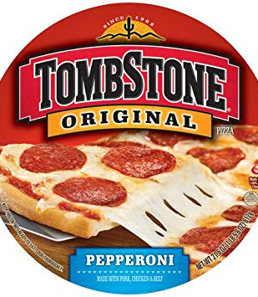
Marketing Predictive Analysis
Group -1
Category : Frozen Pizza

